Slide 1
Lecture 7: Why EV/Hybrid & Hydrogen
technology

Slide 2
WHY ELECTRIC/ HYBRID TECHNOLOGY
Climate change
Rising fuel prices
Rapid Urbanization
Abundant Electricity producing sources
Energy Security
Optimized battery chemistry
Low maintenance
Reliable
Efficient
Zero emissions

Slide 3
WHY HYDROGEN BASED TECHNOLOGY
Renewable and Promptly Available
More Robust and Energy Efficient Compared to Fossil Fuels
Highly Efficient than Other Sources of Energy
Diminishes Carbon Traces
Virtually Zero Emissions
Very Small Noise Pollution
Quick Charging Times
Perfect for Application in Remote Areas
Extended Usage Times
Low Visual Pollution
The Versatility of Adoption
The democratization of Power Supply

Slide 4
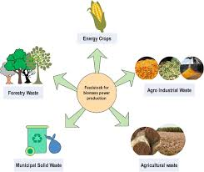
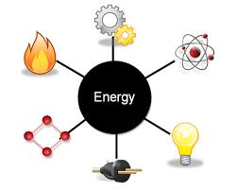
WHY HYDROGEN BASED TECHNOLOGY (2)
Hydrogen is going to be used in the following sectors in the near future:
Stationery Powe Generation
Gas grid interaction
As energy storage medium
with variable solar and wind

Slide 5
• Fertilizer
• Iron and Steel
• Food processing
• Petroleum and
Petrochemical
• Float Glass
• Chemical
• Internal Combustion
Engine (ICE) Vehicles
• Fuel Cell (FO
Vehicles
Industry
Transport
• Gas grid interaction
for cooling or heating
of buildings
• Household applications
like cooking, heating,
cooling, etc.
Storage medium for solar
and Wind
Stationery Power
Generation via Fuel Cell
Cooling of Generators in
Thermal power plants
Domestic
Power

